Slide 1
CELL & MOLECULAR BIOLOGY FOR BIOINFORMATICS SEBB 4173 Chapter 1: Cytoplasmic Membrane
Dr. Noor Hidayah Zakaria

Slide 2
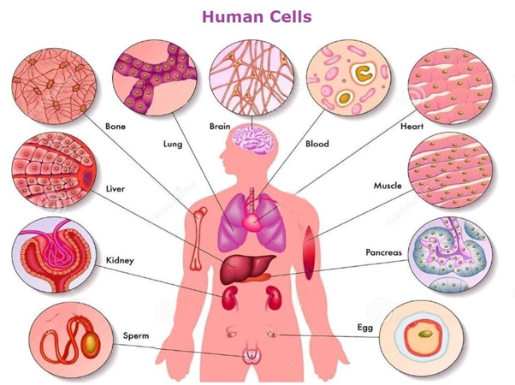
What are cells?

Slide 3
Introduction
A major difference between eukaryotes and prokaryotes is the presence of physical compartments (membrane bound) within the cell.
These compartments allow the separation/specialization of processes within the cell.
Functional compartments are where specific processes may occur or are restricted too.

Slide 4
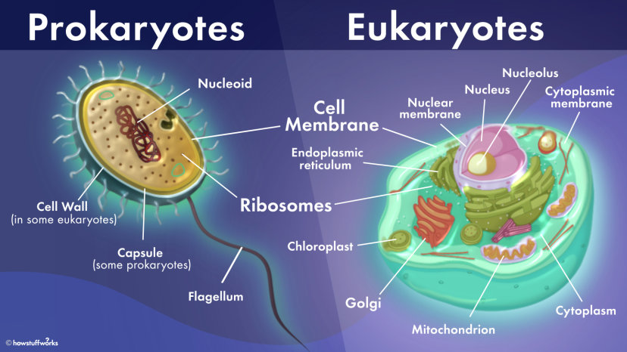
Notes:
Prokaryotic cells are simpler and lack the eukaryote's membrane-bound organelles and nucleus, which encapsulate the cell's DNA

Slide 5
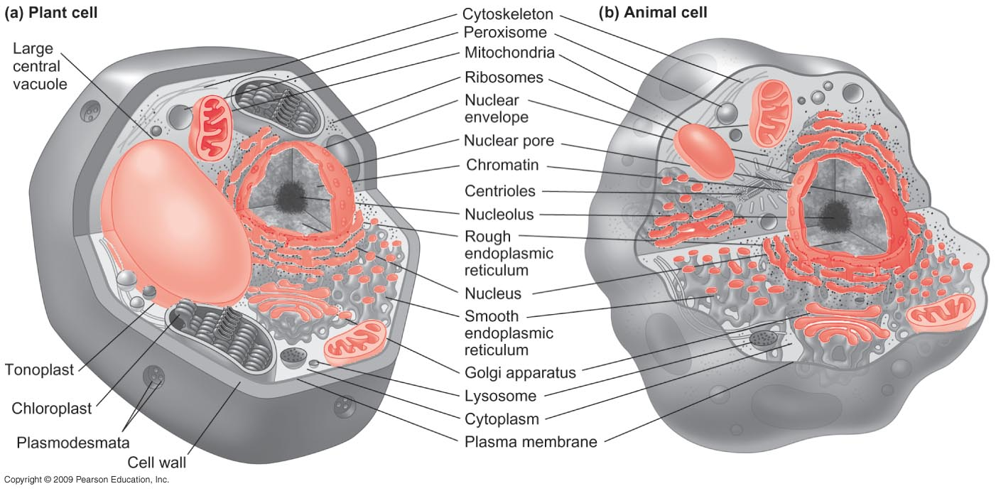
Plant Cells
Animal Cells

Slide 6
Prokaryotes vs Eukaryotes
The difference between eukaryotic and prokaryotic cells has to do with the little stuff-doing parts of the cell, called organelles.
Prokaryotic cells are simpler and lack the eukaryote's membrane-bound organelles and nucleus, which encapsulate the cell's DNA.
Prokaryotes don't have separate compartments for energy production, protein packaging, waste processing or other key functions.“
Eukaryotes have membrane-bound organelles that are used to separate all these processes
Notes:
all humans, animals, plants, fungi and protists (organisms made up of a single cell) are eukaryote

Slide 7
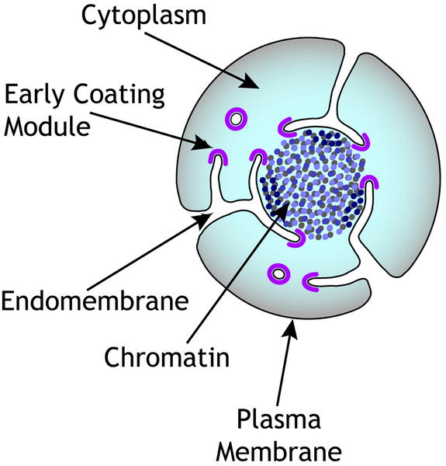
Major cellular compartments
Nucleus (nuclear) - contains a single organelle compartment
Cytoplasm (cytoplasmic) - contains many organelle compartments
Proposed model for organelle membrane evolution

Slide 8
Nuclear compartments
Nuclear matrix - consisting of Intermediate filaments (lamins)
Nucleoli (functional compartment - localised transcription DNA of RNA genes)
Chromosomes (DNA and associated proteins)

Slide 9
Cytoplasmic compartments
Cytoplasmic Organelles
Membrane bound structures
Endoplasmic reticulum, golgi apparatus, mitochondria, lysosomes, peroxisomes, vesicles
Cytoskeleton
3 filament systems
Cytoplasmic “structures”
Ribosomes
DNA -> mRNA -> Protein
Proteins
Receptors, signaling, metabolism, structural
Viruses, bacteria, prionsl
Functional compartments
occur in nucleus, cytoplasm, in organelles and outside organelles
signaling, metabolic reactions, processing genetic information, cytoskeleton dynamics, vesicle dynamics

Slide 10
Cytoplasmic membrane: structure
The cytoplasmic membrane is a thin structure that completely surrounds the cell.
Forms a critical barrier separating the inside of the cell (the cytoplasm) from its environment.
Highly selective barrier, enable the cell to concentrate specific metabolites and excrete waste materials.

Slide 11
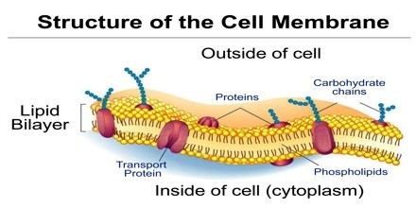

Slide 12
Cytoplasmic membrane: chemical composition
The general structure of most biological membrane is the phospholipid bilayer.
Phospholipids contain:
The highly hydrophobic (fatty acid) and relatively hydrophilic (glycerol) moieties.
Can exist in many different chemical forms as a result of variation in the nature of the fatty acids or phosphate-containing groups attached in an aqueous solution.
Form bilayer structures spontaneously - the fatty acids point inwards.

Slide 13
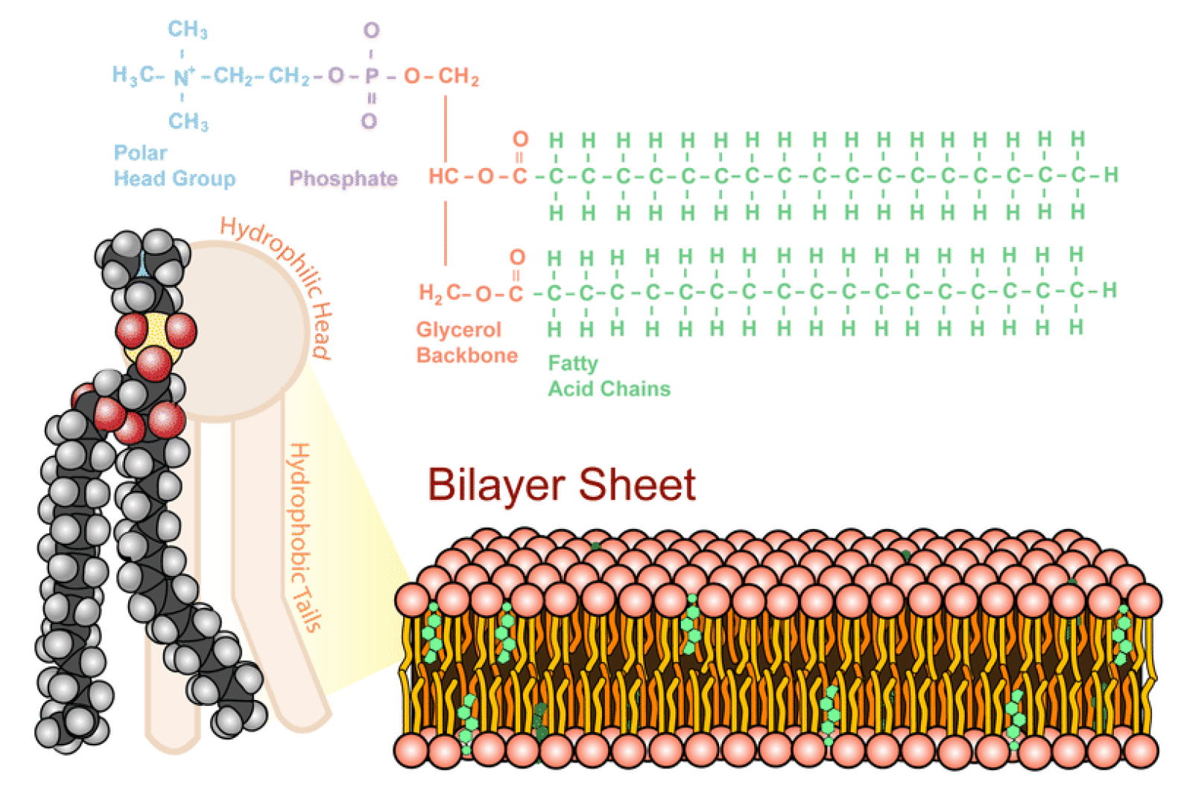
Phospholipids
Phospholipids are emulsifiers, they have the ability to bring water and fat together, two substances which normally do not combine (eg: lecithin)
In the body, phospholipid act as a lipid bilayer in the cell membrane. Most cells will have some sort of phospholipid membrane.

Slide 14
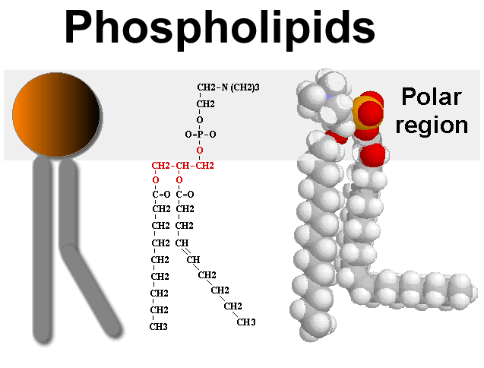
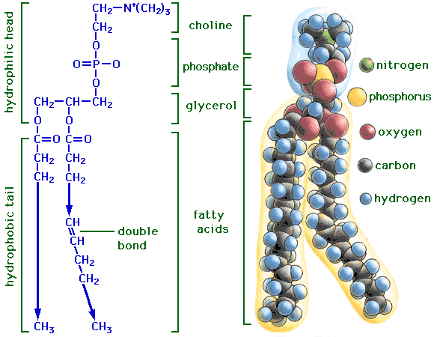

Slide 15
The hydrophilic portions remain exposed to the aqueous-external environment.
the bilayer character of membranes probably represents the most stable arrangement of lipid molecules in an aqueous environment.
The cell membrane consists of:
phospholipid bilayer
proteins embedded within it.

Slide 16
The phospholipid bilayer and associated protein
outside
Hydrophilic region
Fatty acids-highly non-polar
Hydrophobic
region
Glycerol
Phosphate
Protein (has hydrophobic external surface)
inside

Slide 17
Membrane proteins
20-30% of the genome encodes membrane proteins
Proteins can be embedded in the inner phospholipid layer, outer phospholipid layer or span both layers
Some proteins are folded such that they span the membrane in a series of “loops”
Two major protein transmembrane structures
α-helical - ubiquitously distributed
β-barrel - outer membranes of Gram-negative bacteria, chloroplasts, and mitochondria

Slide 18
Membrane Protein Functions
transport channels
enzyme reactions
cytoskeleton link
cell adhesion
cell identity

Slide 19
Three types of membrane proteins:
a. Integral proteins - typically contain one or more transmembrane helices.
b. Peripheral proteins - are non-covalently bonded to the polar head groups of the lipid bilayer and/or to an integral membrane protein.
c. Lipid-anchored proteins - are covalently bonded either to a phospholipid or a fatty acid that is embedded in one of the leaflets of the lipid bilayer.

Slide 20
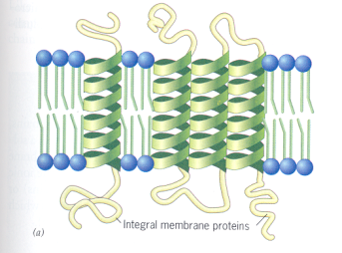
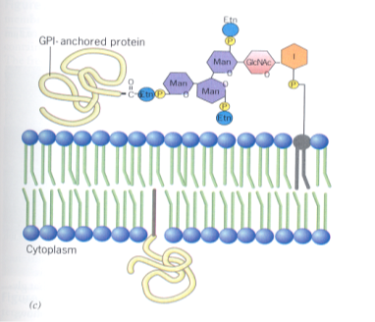
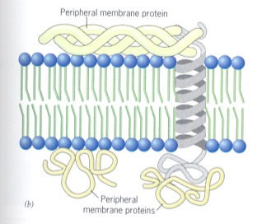
a
Integral Membrane Proteins
c
Lipid Anchored Proteins
I: inositol
GlcNac: N-acetylglucosamine;
Man: Mannose
Etn: ethanolamine.
b
Peripheral Membrane Proteins

Slide 21
Classes of transport protein
Three classes of transport proteins :
Uniporters: transport substance from one side of the membrane to the other.
Symporters: carry both substances across the membrane in the same direction.
Antiporters: transport one substance across the membrane in one direction while transporting the second substance in the opposite direction.
Sym- and antiporters are co-transport proteins- transport proteins by moving the substance of interest across the membrane along with a second substance required for transport of the first.

Slide 22
Transported molecule
Co-transported molecules
uniporter
symporter
antiporter

Slide 23
Three major forms of transport across the membrane
Passive - Simple diffusion
Facilitated - transport proteins
Active - transport proteins for nutrient uptake, secretion, ion balance

Slide 24
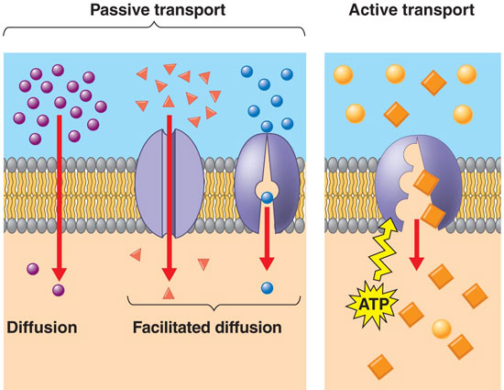

Slide 25
Active transport: overcome the transport problem by enabling the cell to accumulate solutes against a concentration gradient.
Passive carrier-mediated transport: shows a saturation effect- if the concentration of the substrate in the medium is high enough to saturate the carrier (which is frequently the case even at quite low substrate concentrations) the rate of uptake and the internal level becomes maximal.

Slide 26
Active transport
Active carrier-mediated transport processes are highly specific.
The binding and carrying of a substance across the membrane resembles an enzyme action.
Certain carrier proteins react only with a single kind of molecule, but many show affinities for a chemical class of molecules (amino acids/sugars).

Slide 27
The action and energy requirements of transport proteins
Membrane transport proteins are generally integral proteins.
Solute is carried through the membrane by a conformational change in the transport protein.
Most transport processes are linked to the spending of energy; result in a much higher concentration of the transported molecules inside than outside the cell.
Energy is used to pump the solute against the concentration gradient.

Slide 28
Conformational change of membrane proteins
Outside
Solute
Inside
Conformational change results in lost of cup
Conformational change
Transport protein

Slide 29
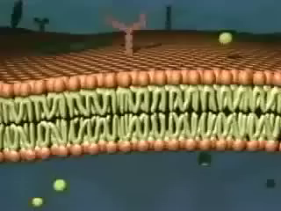

Slide 30
Where does the energy come from?
Either:
i. high energy phosphate compounds, e.g. adenosine triphosphate (ATP)
or
ii. by the dissipation of a gradient of protons or sodium ions across the membrane.
The ion gradients are established during energy-releasing reactions in the cell.

Slide 31
Two major different mechanisms of energy-linked transport are:
Group translocation: substance is transported while simultaneously being chemically modified, generally by phosphorylation.
Active transport: substance can accumulate to a high concentration in the cytoplasm in chemically unaltered form. Active transport is linked to the energy available in ion gradients or ATP.

Slide 32
Mechanism 1: Group Translocation
Substances are chemically altered in the course of passage across the membrane.
Since the product that appears inside the cell is chemically different from the external substrate, no actual concentration gradient of external solute per se is produced.
E.g. transport of the sugars glucose, mannose, fructose, N-acetylglucosamine, and β-glucosides, phophorylated during transport by the phosphotransferase system.

Slide 33
The Phosphotransferase System
E. coli phosphotransferase system: composed of 24 proteins, at least four are necessary to transport a given sugar.
The proteins in the phosphotransferase system are themselves alternately phosphorylated and dephosphorylated in a cascading fashion.
Enzyme IIc (a transmembrane transport protein) then receives the phosphate group and phosphorylates the sugar.

Slide 34
The Phosphotransferase System
Transmembrane protein
Cytoplasmic proteins
PEP
Enz I
Enz IIa
Enz IIb
Enz IIc
Hpr
Enz IIc
glucose
Non-specific components
Specific components
+
Pyruvate
Phosphate
INSIDE
OUTSIDE
Glucose unit
Phosphate group
Notes:
phosphoenol pyruvate (PEP)

Slide 35
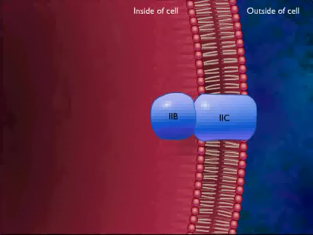

Slide 36
Mechanism 2: Active Transport
Is an energy-dependent pumping system.
Substance being transported combines with a membrane-bound carrier (membrane protein), which then releases the chemically unchanged substance inside the cell.
Since the substance is not altered during the transport process (if it is not consumed in cell reactions) the concentration inside may reach many times the external concentration.

Slide 37
Substances Transported by Active Transport
some sugars like glucose
most amino acids
organic acids
a number of inorganic ions such as sulfate, phosphate, and potassium.
Note: Glucose is taken up by active transport processes in some bacteria and by the phosphotransferase system in others. As in any other pump, active transport requires that work be performed.

Slide 38
The Energy Source
In bacteria, the energy for driving the pump comes from:
ATP (some transporters),
From the separation of hydrogen ions (protons) across the membrane - proton motive force (PMF) (more commonly).
PMF: Energy released from the breakdown of organic or inorganic compounds, or from the energy of light, is used to establish a separation of protons across the membrane, resulting in the proton concentration highest outside the cell and lowest inside.

Slide 39
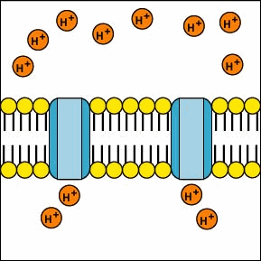

Slide 40
This proton pump results in an energised membrane. It is the electrochemical potential residing in the PMF that drives the uptake of nutrients by active transport.
Each membrane carrier involved in active transport has specific sites for both its substrate (for exampIe, glucose or potassium) and a proton (or protons).
As the substrate is taken up, protons move across the membrane and the PMF is diminished.

Slide 41
H⁺
Na+
+
+
H⁺
HPO₄²⁻
+
H⁺
OH-
H+
Sodium-proton antiporter
H⁺
OH-
+
H+
H+
Phosphate symporter
H⁺
+
OH-
OH-
+
Potassium uniporter
H⁺
K⁺
OH-
Sulfate symporter
+
Outside
H⁺
Inside
HSO₄⁻
H⁺
+
H+
+
H+
+

